Slide 2
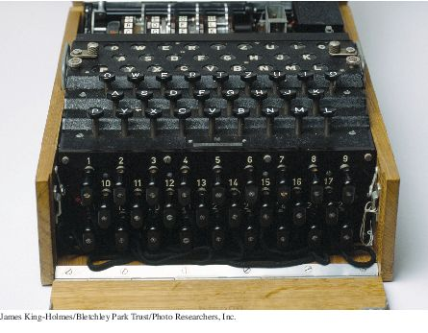
Chapter Goals
To read and write text files
To throw and catch exceptions

Slide 3
Reading and Writing Text Files - Reading
Use Scanner class for reading text files
To read from a disk file:
Construct a File object representing the input file
File inputFile = new File("input.txt");
Use this File object to construct a Scanner object:
Scanner in = new Scanner(inputFile);
Use the Scanner methods to read data from file
next, nextInt, and nextDouble

Slide 4
Reading and Writing Text Files - Reading
A loop to process numbers in the input file:
while (in.hasNextDouble())
{
double value = in.nextDouble();
Process value.
}

Slide 5
Reading and Writing Text Files - Writing
To write to a file, construct a PrintWriter object:
PrintWriter out = new PrintWriter("output.txt");
If file already exists, it is emptied before the new data are written into it.
If file doesn't exist, an empty file is created.
Use print and println to write into a PrintWriter:
out.println("Hello, World!");
out.printf("Total: %8.2f\n", total);
You must close a file when you are done processing it:
in.close();
out.close();
Otherwise, not all of the output may be written to the disk file.
Always specify "UTF-8" as the second parameter when construction a Scanner or a PrintWriter.

Slide 6
FileNotFoundException
When the input or output file doesn't exist, a FileNotFoundException can occur.
To handle the exception, label the main method like this:
public static void main(String[] args) throws FileNotFoundException

Slide 7
Reading and Writing Text Files - Example
Read a file containing numbers
Sample input
32 54 67.5 29 35 80
115 44.5 100 65
Write the numbers in a column followed by their total
Output from sample input
32.00
54.00
67.50
29.00
35.00
80.00
115.00
44.50
100.00
65.00
Total: 622.00

Slide 8
section_1/Total.java
1 import java.io.File;
2 import java.io.FileNotFoundException;
3 import java.io.PrintWriter;
4 import java.util.Scanner;
5
6 /**
7 This program reads a file with numbers, and writes the numbers to another
8 file, lined up in a column and followed by their total.
9 */
10 public class Total
11 {
12 public static void main(String[] args) throws FileNotFoundException
13 {
14 // Prompt for the input and output file names
15
16 Scanner console = new Scanner(System.in);
17 System.out.print("Input file: ");
18 String inputFileName = console.next();
19 System.out.print("Output file: ");
20 String outputFileName = console.next();
21
22 // Construct the Scanner and PrintWriter objects for reading and writing
23
24 File inputFile = new File(inputFileName);
25 Scanner in = new Scanner(inputFile);
26 PrintWriter out = new PrintWriter(outputFileName);
27
Continued

Slide 9
section_1/Total.java
28 // Read the input and write the output
29
30 double total = 0;
31
32 while (in.hasNextDouble())
33 {
34 double value = in.nextDouble();
35 out.printf("%15.2f\n", value);
36 total = total + value;
37 }
38
39 out.printf("Total: %8.2f\n", total);
40
41 in.close();
42 out.close();
43 }
44 }

Slide 10
Text Input and Output
The next method of the Scanner class reads a string that is delimited by white space.
A loop for processing a file
while (in.hasNext())
{
String input = in.next();
System.out.println(input);
}
If the input is "Mary had a little lamb", the loop prints each word on a separate line
Mary
Had
A
Little
lamb

Slide 11
Text Input and Output
The next method returns any sequence of characters that is not white space.
White space includes: spaces, tab characters, and the newline characters that separate lines.
These strings are considered “words” by the next method
Snow.
1729
C++

Slide 12
Text Input and Output
When next is called:
Input characters that are white space are consumed - removed from the input
They do not become part of the word
The first character that is not white space becomes the first character of the word
More characters are added until
Either another white space character occurs
Or the end of the input file has been reached
If the end of the input file is reached before any character was added to the word
a “no such element exception” occurs.

Slide 13
Text Input and Output
To read just words and discard anything that isn't a letter:
Call useDelimiter method of the Scanner class
Scanner in = new Scanner(. . .);
in.useDelimiter("[^A-Za-z]+");
. . .
The word separator becomes any character that is not a letter.
Punctuation and numbers are not included in the words returned by the next method.

Slide 14
Text Input and Output – Reading Characters
To read one character at a time, set the delimiter pattern to the empty string:
Scanner in = new Scanner(. . .);
in.useDelimiter("");
Now each call to next returns a string consisting of a single character.
To process the characters:
while (in.hasNext())
{
char ch = in.next().charAt(0);
Process ch
}

Slide 15
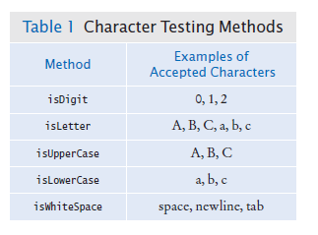
Text Input and Output – Classifying Characters
The Character class has methods for classifying characters.

Slide 16
Text Input and Output – Reading Lines
The nextLine method reads a line of input and consumes the newline character at the end of the line:
String line = in.nextLine();
The hasNextLine method returns true if there are more input lines, false when all lines have been read.
Example: process a file with population data from the CIA Fact Book with lines like this:
China 1330044605
India 1147995898
United States 303824646
...

Slide 17
Text Input and Output – Reading Lines
Read each input line into a string
while (in.hasNextLine())
{
String line = nextLine();
Process line.
}
Then use the isDigit and isWhitespace methods to find out where the name ends and the number starts.
To locate the first digit:
int i = 0;
while (!Character.isDigit(line.charAt(i))) { i++; }
To extract the country name and population:
String countryName = line.substring(0, i);
String population = line.substring(i);

Slide 18
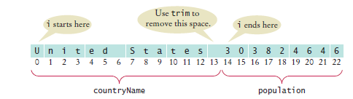
Text Input and Output – Reading Lines
Use trim to remove spaces at the beginning and end of string:
countryName = countryName.trim();
Note that the population is stored in a string.

Slide 19
Text Input and Output – Scanning a String
Occasionally easier to construct a new Scanner object to read the characters from a string:
Scanner lineScanner = new Scanner(line);
Then you can use lineScanner like any other Scanner object, reading words and numbers:
String countryName = lineScanner.next();
while (!lineScanner.hasNextInt())
{
countryName = countryName + " " + lineScanner.next();
}
int populationValue = lineScanner.nextInt();

Slide 20
Text Input and Output - Converting Strings to Numbers
If a string contains the digits of a number.
Use the Integer.parseInt or Double.parseDouble method to obtain the number value.
If the string contains "303824646"
Use Integer.parseInt method to get the integer value
int populationValue = Integer.parseInt(population);
// populationValue is the integer 303824646
If the string contains "3.95"
Use Double.parseDouble
double price = Double.parseDouble(input);
// price is the floating-point number 3.95
The string must not contain spaces or other non-digits. Use trim:
int populationValue = Integer.parseInt(population.trim());

Slide 21
Avoiding Errors When Reading Numbers
If the input is not a properly formatted number when calling nextInt or nextDouble method
input mismatch exception occurs
For example, if the input contains characters:
White space is consumed and the word 21st is read.
21st is not a properly formatted number
Causes an input mismatch exception in the nextInt method.
If there is no input at all when you call nextInt or nextDouble,
A “no such element exception” occurs.
To avoid exceptions, use the hasNextInt method
if (in.hasNextInt()) { int value = in.nextInt(); . . . }

Slide 22
Mixing Number, Word, and Line Input
The nextInt, nextDouble, and next methods do not consume the white space that follows the number or word.
This can be a problem if you alternate between calling nextInt/nextDouble/next and nextLine.
Example: a file contains country names and populations in this format:
China
1330044605
India
1147995898
United States
303824646

Slide 23
Mixing Number, Word, and Line Input
The file is read with these instructions:
while (in.hasNextLine())
{
String countryName = in.nextLine();
int population = in.nextInt();
Process the country name and population.
}

Slide 24


Mixing Number, Word, and Line Input
Initial input
Input after first call to nextLine
Input after call to nextInt
nextInt did not consume the newline character
The second call to nextLine reads an empty string!
The remedy is to add a call to nextLine after reading the population value:
String countryName = in.nextLine();
int population = in.nextInt();
in.nextLine(); // Consume the newline

Slide 25
Mixing Number, Word, and Line Input
Example of the issue:
import java.util.Scanner;
public class ScanTest1 {
public static void main(String[] args)
{
// Prompt for a name and age three times
Scanner console = new Scanner(System.in);
for (int i=0;i<3;i++) {
System.out.print("Name: ");
String inname = console.nextLine();
System.out.print("Age: ");
int inage = console.nextInt();
}
}

Slide 26
Mixing Number, Word, and Line Input
Name: Mimi
Age: 19
Name: Age: 5
Name: Age: 3
Press any key to continue . . .

Slide 27
Mixing Number, Word, and Line Input
Example of the Fix:
import java.util.Scanner;
public class ScanTest2 {
public static void main(String[] args)
{
// Prompt for a name and age three times
Scanner console = new Scanner(System.in);
for (int i=0;i<3;i++) {
System.out.print("Name: ");
String inname = console.nextLine();
System.out.print("Age: ");
int inage = console.nextInt();
console.nextLine();
}
}
}

Slide 28
Mixing Number, Word, and Line Input
Name: Mimi
Age: 20
Name: Sam
Age: 30
Name: DeeDee
Age: 8
Press any key to continue . . .

Slide 29
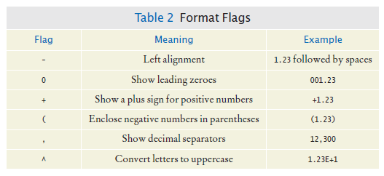
Formatting Output
There are additional options for printf method.
Format flags

Slide 30
Formatting Output
Example: print a table of items and prices, each stored in an array
Cookies: 3.20
Linguine: 2.95
Clams: 17.29
The item strings line up to the left; the numbers line up to the right.

Slide 31
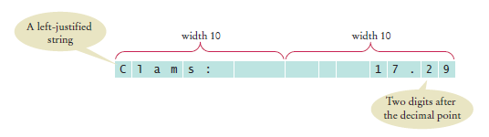
Formatting Output
To specify left alignment, add a hyphen (-) before the field width:
System.out.printf("%-10s%10.2f", items[i] + ":", prices[i]);
There are two format specifiers: "%-10s%10.2f"
%-10s
Formats a left-justified string.
Padded with spaces so it becomes ten characters wide
%10.2f
Formats a floating-point number
The field that is ten characters wide.
Spaces appear to the left and the value to the right
The output

Slide 32
Formatting Output
A format specifier has the following structure:
The first character is a %.
Next are optional “flags” that modify the format, such as - to indicate left alignment.
Next is the field width, the total number of characters in the field (including the spaces used for padding), followed by an optional precision for floating-point numbers.
The format specifier ends with the format type, such as f for floating-point values or s for strings.

Slide 33
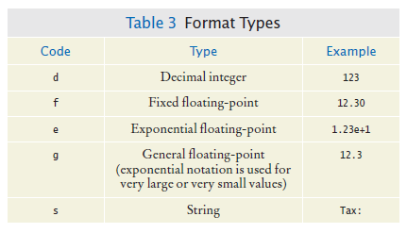
Formatting Output
Format types

Slide 34
Command Line Arguments
You can run a Java program by typing a command at the prompt in the command shell window
Called “invoking the program from the command line”
With this method, you can add extra information for the program to use
Called command line arguments
Example: start a program with a command line
java ProgramClass -v input.dat
The program receives the strings "-v" and "input.dat" as command line arguments
Useful for automating tasks

Slide 35
Command Line Arguments
Your program receives its command line arguments in the args parameter of the main method:
public static void main(String[] args)
In the example, args is an array of length 2, containing the strings
args[0]: "-v”
args[1]: "input.dat"

Slide 36

Command Line Arguments
Example: a program that encrypts a file
Use a Caesar Cipher that replaces A with a D, B with an E, and so on
Sample text
The program will take command line arguments
An optional -d flag to indicate decryption instead of encryption
The input file name
The output file name
To encrypt the file input.txt and place the result into encrypt.txt
java CaesarCipher input.txt encrypt.txt
To decrypt the file encrypt.txt and place the result into output.txt
java CaesarCipher -d encrypt.txt output.txt

Slide 37
Exception Handling - Throwing Exceptions
Exception handling provides a flexible mechanism for passing control from the point of error detection to a handler that can deal with the error.
When you detect an error condition, throw an exception object to signal an exceptional condition
If someone tries to withdraw too much money from a bank account
Throw an IllegalArgumentException
IllegalArgumentException exception =
new IllegalArgumentException("Amount exceeds balance");
throw exception;

Slide 38
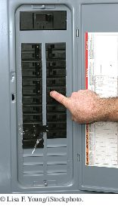
Exception Handling - Throwing Exceptions
When an exception is thrown, method terminates immediately
Execution continues with an exception handler
When you throw an exception, the normal control flow is terminated. This is similar to a circuit breaker that cuts off the flow of electricity in a dangerous situation.

Slide 39
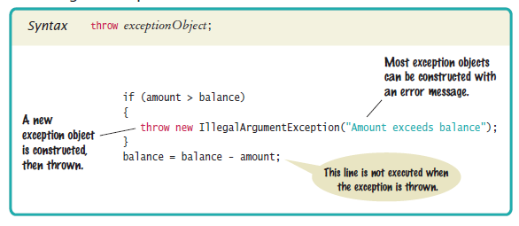
Syntax 11.1 Throwing an Exception

Slide 40
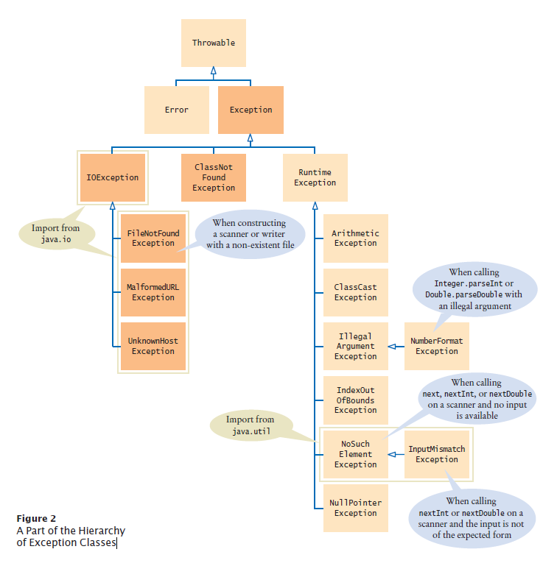
Hierarchy of Exception Classes
Figure 2 A Part of the Hierarchy of Exception Classes

Slide 41
Catching Exceptions
Every exception should be handled somewhere in your program
Place the statements that can cause an exception inside a try block, and the handler inside a catch clause.
try
{
String filename = . . .;
Scanner in = new Scanner(new File(filename));
String input = in.next();
int value = Integer.parseInt(input);
. . .
}
catch (IOException exception)
{
exception.printStackTrace();
}
catch (NumberFormatException exception)
{
System.out.println(exception.getMessage());
}

Slide 42
Catching Exceptions
Three exceptions may be thrown in the try block:
The Scanner constructor can throw a FileNotFoundException.
Scanner.next can throw a NoSuchElementException.
Integer.parseInt can throw a NumberFormatException.
If any of these exceptions is actually thrown, then the rest of the instructions in the try block are skipped.

Slide 43
Catching Exceptions
What happens when each exception is thrown:
If a FileNotFoundException is thrown,
then the catch clause for the IOException is executed because FileNotFoundException is a descendant of IOException.
If you want to show the user a different message for a FileNotFoundException, you must place the catch clause before the clause for an IOException
If a NumberFormatException occurs,
then the second catch clause is executed.
A NoSuchElementException is not caught by any of the catch clauses.
The exception remains thrown until it is caught by another try block.

Slide 44
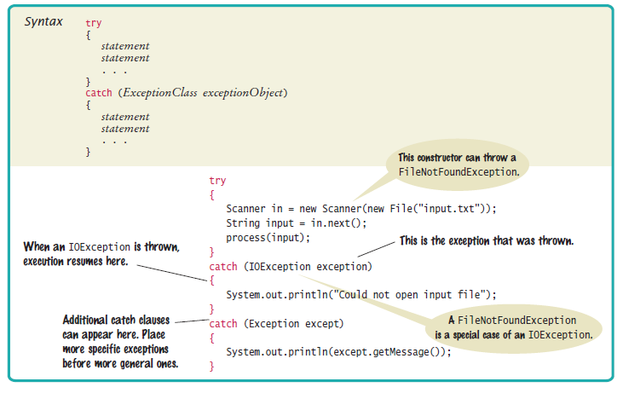
Syntax 11.2 Catching Exceptions

Slide 45

Catching Exceptions
Each catch clause contains a handler.
Our example just informed the user of a problem.
Often better to give the user another chance.
When you throw an exception, you can provide your own message string.
For example, when you call
throw new IllegalArgumentException("Amount exceeds balance");
the message of the exception is the string provided in the constructor.
You should only catch those exceptions that you can handle.

Slide 46
Checked Exceptions
Exceptions fall into three categories
Internal errors are reported by descendants of the type Error.
Example: OutOfMemoryError
Descendants of RuntimeException,
Example: IndexOutOfBoundsException or IllegalArgumentException
Indicate errors in your code.
They are called unchecked exceptions.
All other exceptions are checked exceptions.
Indicate that something has gone wrong for some external reason beyond your control
Example: IOException

Slide 47
Checked Exceptions
Checked exceptions are due to external circumstances that the programmer cannot prevent.
The compiler checks that your program handles these exceptions.
The unchecked exceptions are your fault.
The compiler does not check whether you handle an unchecked exception.

Slide 48
Checked Exceptions - throws
You can handle the checked exception in the same method that throws it
try
{
File inFile = new File(filename);
Scanner in = new Scanner(inFile); // ThrowsFileNotFoundException
. . .
}
catch (FileNotFoundException exception) // Exception caught here
{
. . .
}

Slide 49
Checked Exceptions - throws
Often the current method cannot handle the exception. Tell the compiler you are aware of the exception
You want the method to terminate if the exception occurs
Add a throws clause to the method header
public void readData(String filename) throws FileNotFoundException
{
File inFile = new File(filename);
Scanner in = new Scanner(inFile);
. . .
}

Slide 50

Checked Exceptions - throws
The throws clause signals to the caller of your method that it may encounter a FileNotFoundException.
The caller must decide
To handle the exception
Or declare the exception may be thrown
Throw early, catch late
Throw an exception as soon as a problem is detected.
Catch it only when the problem can be handled
Just as trucks with large or hazardous loads carry warning signs, the throws clause warns the caller that an exception may occur.

Slide 51
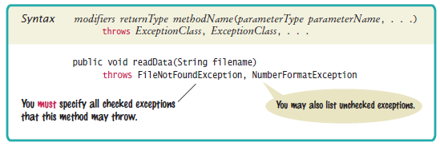
Syntax 11.3 throws Clause

Slide 52
The finally Clause
Once a try block is entered, the statements in a finally clause are guaranteed to be executed - whether or not an exception is thrown.
Use when you do some clean up
Example - closing files
PrintWriter out = new PrintWriter(filename);
try
{
writeData(out);
}
finally
{
out.close();
}
Executes the close even if an exception is thrown.

Slide 53

The finally Clause
All visitors to a foreign country have to go through passport control, no matter what happened on their trip. Similarly, the code in a finally clause is always executed, even when an exception has occurred.

Slide 54
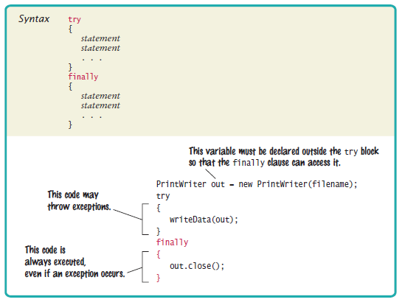
Syntax 11.4 finally Clause

